Slide 1
Chapter 4: Section 3 continued
Genes

Slide 2
Importance of DNA
All of the characteristics that you have are affected by the DNA that you have in your cells.
It controls things like eye color, hair color, and whether you can digest milk.
These characteristics are called TRAITS.
How traits appear in you depends on the kinds of proteins your cells make.
DNA stores the blueprints for making proteins.

Slide 3
Genes
Proteins are made up of amino acids.
Amino acids are linked in a certain order.
The chain can be hundreds or thousands of amino acids to create one protein.
Changing the order of one amino acid would change the type of protein being made.

Slide 4
Genes continued…
gene: the section of DNA for a chromosome that directs the making of a specific protein.
The gene gives the direction for the order in which amino acids will be made.

Slide 5
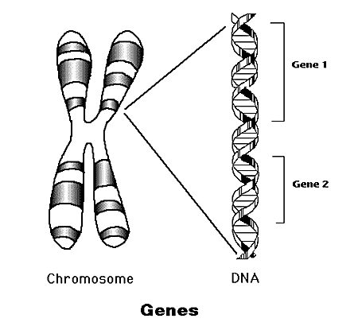

Slide 6
Facts About Genes
We have at least 30,000 different genes.
Each of us has two copies of every gene.
One set of copies is inherited from our mother, the other from our father.
made of DNA
DNA controls all the processes which take place in our bodies by producing proteins which carry out the genes’ instructions.

Slide 7
Facts About Genes continued…
When genes are damaged they may cause the production of abnormal proteins that lead to disease.
It is known that cancer can occur due to changes in particular genes

Slide 8
