Slide 1
Chapter 3: Cell Processes
Section 1: Chemistry of Life

Slide 2
Chemistry of Life
Energy: Anything that brings about change. It can hold things together or break this apart.
Matter: anything that has mass and takes up space
Matter is made up of atoms
atoms = smallest units of anything
Atoms are made up of 3 smaller particles:
1) protons – (+) charge
2) neutrons – (0) charge
3) electrons – (-) charge

Slide 3
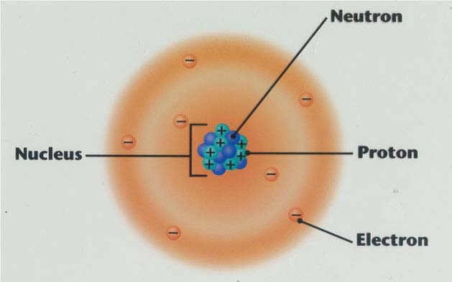
Nucleus
Center of the atom
contains 2 of those subatomic particles: protons and neutrons
Charge of the nucleus = positive

Slide 4
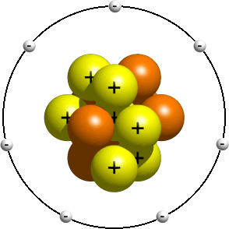
Electrons
live outside the nucleus in a region called the electron cloud
Electrons are important because they are the parts that are involved with all chemical reactions.
Electrons are the smallest particle in the atom.

Slide 5
Elements
element: something that is made up of only one kind of atom
Can’t be broken down into simpler forms
Each Element is given a 1,2 or 3 letter symbol. These symbols are from the Latin language.
found on the Periodic Table

Slide 6
Periodic Table
a list of all elements by size.
The smallest are in the upper left (H) and the heaviest are at the bottom right (#118)
The table shows the name, symbol, how many protons it has.

Slide 7
Elements Continued…
99% of all living matter are made up of 6 elements.
Humans
O- Oxygen 65%
C – Carbon 18.5%
H – Hydrogen 9.5%

Slide 8
Compounds
substance made up of 2 or more elements in exact proportions.
EX: water is always 2 H to 1 O or H₂O
Compounds appear differently than the original substances.
EX: Hydrogen alone is a poisonous gas. Oxygen alone is a gas
Together they make vital liquid water.

Slide 9
Two Types of Compounds
1.) molecules: group of atoms held together by energy of chemical bonds
They form when different atoms share their outermost electrons.
covalent bonding
Water is an example because 2 H share electrons with 1 O.
The end result is always different than the original substances.
Water is a liquid and H and O alone are gases.

Slide 10
2.) Ions: Compounds that form when atoms of opposite charge connect. These are atoms with a charge either + or -.
Atoms are usually neutral – no overall charge. This means the protons = the electrons.
Sometimes however an atom has more electrons than protons, giving it an overall – charge these are called anion.
Ex: Chlorine (Cl-)
If the atom has more protons than electrons it’s charge is + and is called a cation
.Ex: Sodium (Na+)

Slide 11
Ions of opposite charge attract one another and form ionic compounds.
EX: Na+ + Cl- = NaCl (Table Salt)
Ions are very important inside the human body.

Slide 12
Mixtures
Mixture: When 2 substances join together but keep their own properties.
EX: Ice Tea, Italian Salad Dressing, Blood
Solution: 2 or more substances mixed evenly.
EX: Sweat, Ice Tea
homogenous
Suspension: 2 or more substances that will eventually settle out.
EX: Italian Salad Dressing, Blood
heterogeneous

Slide 13
Organic Compounds
Substances that contain Carbon and Hydrogen and are associated with living things
Some exceptions are things that are non living but were made from once living things.
EX: COAL – made from dead and decaying plants.
4 main kinds of organic compounds
carbohydrates
lipids
proteins
nucleic acids

Slide 14
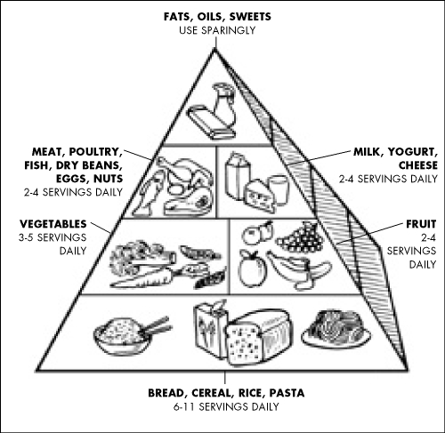

Slide 15
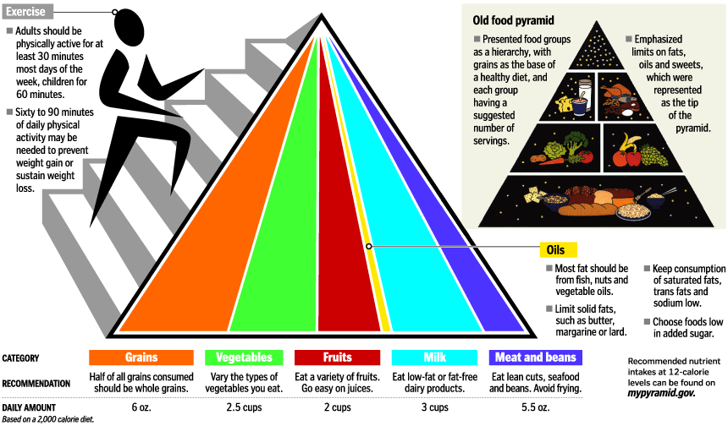

Slide 16
Carbohydrates
job: To supply energy for cell processes.
It is the main energy source for the cells.
Carbs are made of sugars and starches.
Some examples of food rich in carbs are: potatoes, veggies, fruits, breads, rice, pastas.
In the food pyramid, you should eat the most carbs of any other food daily.
If active carbohydrates will be completely burned up during the course of the day.

Slide 17
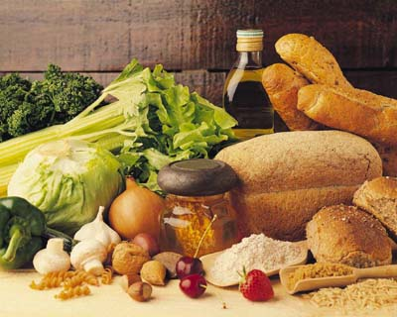

Slide 18
Lipids
job: An energy backup for cells.
If not used it is stored as fat called cellulite.
Once stored it is very hard to lose.
Fats and oils are examples of lipids.
Foods rich in lipids: Mayo, Salad Dressing, Ice Cream, Dairy products, Candy, Chocolate, Oil, Butter, etc.
A human only needs very small amounts of lipids daily.

Slide 19
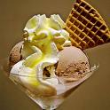
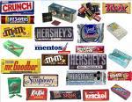

Slide 20
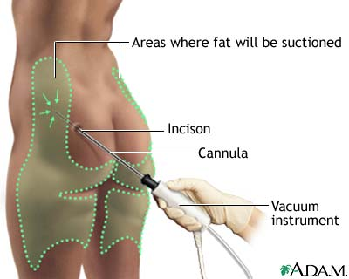
Cellulite

Slide 21
Proteins
job: responsible for all chemical reactions that occur inside the human body
Made up of Amino Acids (20)
Special kinds of proteins called enzymes regulate the rate of all those chemical reactions.
EX: saliva – helps break down carbohydrates in the mouth faster.

Slide 22
Proteins Continued…
lactase – Helps break down dairy
foods rich in proteins are: Meats, Fruits, Veggies, Fish, Eggs, Peanut Butter, Nuts, Beans
Vegetarians need to be careful to make sure they get enough proteins in their diet.

Slide 23
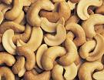
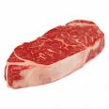

Slide 24
Nucleic Acids
job: responsible for all genetic information in cells
2 types
1. DNA – Deoxyribonucleic Acid – creates all the genetic information for cells. Found in the nucleus.
2. RNA – Ribonucleic Acid – Carries the DNA to all cell parts. It also makes proteins and enzymes.
most complex of all organic compounds

Slide 25
Clips on nutrition
1) Understanding the Food Groups http://www.youtube.com/watch?v=8cCLLtFC6EA
2)Food and Teens http://www.youtube.com/watch?v=uihDgVeKSMk
3)Nutrition Song - http://www.youtube.com/watch?v=6fhSGWdbm9g

Slide 26
Inorganic Compounds
Made from other elements besides carbon.
Normally they are simpler than organic.
ex. water, calcium phosphate, hydrochloric acid, sodium bicarbonate, salts containing sodium, chlorine, and potassium
Most important inorganic compound for living things is water.
life is composed of at least 50% water
human cells are made up of at least 70% water

Slide 27
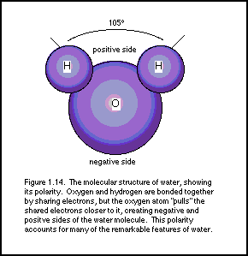
Importance of Water
Animals can live for only days without water but can live weeks without food.
Every chemical reaction in the body needs to be in a watery solution. Blood.
Water is made up of 2 Hydrogen and 1 Oxygen.
So water has a negative side and a positive side.
http://www.youtube.com/watch?v=_MgJM3tJs3E

