Slide 1
Chapter 2: Section 2
Microscopes

Slide 2
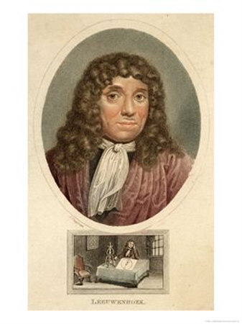
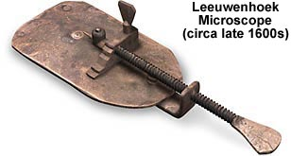
Viewing Cells
microscope: a scientific instrument designed to see things that are too small for the naked eye
uses lens to make things APPEAR closer than they are
Anton van Leeuwenhoek
made a simple microscope with 1 lens
witnessed seeing things in a pond water never before seen

Slide 3
History of Microscopes
1665: Robert Hooke was the first person to see cells under a microscope
looked at a thin slice of cork and saw empty little boxes he called cells
1830’s: Matthias Schleiden studied plants and found they all also had these little cells
Same year: Theodor Schwann looked at animals and all had cells
Even though Hooke is dead → this makes him look like a genius

Slide 4
Several years after..
Rudolf Virchow observed cells dividing and proposed that all cells come from other cells that are already existing
THESE FOUR SCIENTISTS OVER THE YEARS WERE RESPONSIBLE FOR CREATING THE CELL THEORY
All organisms are made up of 1 or more cells
the cell is the basic unit of organization in organisms
all cells come from other cells

Slide 5
TYPES OF MICROSCOPES
simple: only have one lens → similar to a magnifying glass
compound light microscope: have 3 lenses inside them
one in eye piece, one in tube, and one in objective
because there is an odd number of lenses, all images will be upside down and reversed!!
is used for magnification
when you use each power, you can figure out the total magnification for each one

Slide 6
types of lenses
convex: lenses that look like a teardrop and magnifies
example: microscopes, farsightedness
concave: lens that look like an hourglass and bends light inward
good at looking at far away objects
example: telescopes, binoculars, nearsightedness

Slide 7
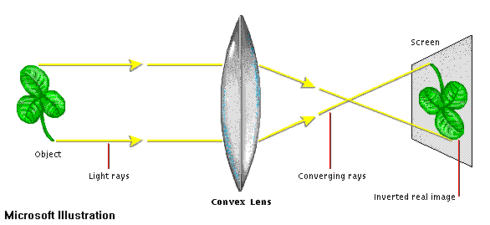
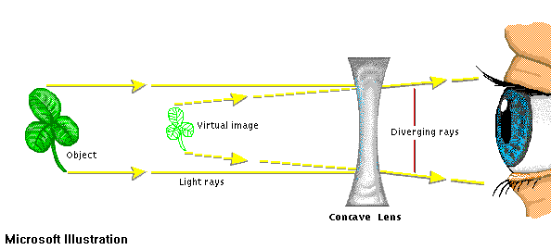
CONVEX VS CONCAVE

Slide 8
TOTAL MAGNIFICATION
Lower Power
Eyepiece (10x) X Objective lens (4x) = 40X
Medium Power
Eyepiece (10x) X Objective lens (10x) = 100X
High Power
Eyepiece (10x) X Objective lens (40x) = 400X
The compound light microscope can magnify up to 2000x.

Slide 9
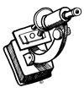
Parts of a compound microscope
1.) Eyepiece: where you look into → has a lens of 10X
2.) Course Adjustment Knob: usually used first in order to bring an object into rough focus (larger knob)
3.) Fine Adjustment Knob: used second and brings the object into perfect focus (smaller knob)
4.) Arm: used to carry the microscope

Slide 10
Parts continued…
5.) High Power Objective: has a lens of 40X; always used last and is the longest of the objectives
6.) Medium Power Objective: lens of 10X; is the one used in the middle
7.) Low Power Objective: lens of 4x and is always used first and is the shortest
8.) Stage Clips: steel clips to lock the slide onto the stage

Slide 11
Parts continued…
9.) Diaphragm: the disc that regulates the amount of light entering the slide platform
- Sometimes this will need to be adjusted →more light or less
10.) Base: the support for the scope
11.) Light: the illumination for the scope
12.) Revolving Nosepiece: the part that moves the objectives into place

Slide 12
a THIRD TYPE OF MICROSCOPE
Electron Microscope: uses beams of light, a magnetic field inside a vacuum to view objects too small to otherwise be seen
Types of Electron Microscopes
1.) Scanning Electron Microscope (SEM):produces a 3-D image of the surface of a cell; magnifies around 200,000x
2.) Transmission Electron Microscope (TEM): produces a 2-D image of a thinly sliced specimen; magnifies up to 1,000,000x

Slide 13
Other tools we will be using
1.) Water: placed between the slide and coverslip to provide suction
(WET MOUNT)
2.) Coverslip: place it on the slide on a 45 degree angle to push out water bubbles
________________
3.) Iodine: stain used to make cell parts more visible

Slide 14
RULES WHEN USING THE Microscopes
1.) Use arm and base to carry
2.) Always start on low power, then medium power and high at the end
3.) Use the coarse adjustment knob first, then the fine adjustment
4.) Always center the specimen first before changing powers

Slide 15
rules continued…
5.) Never use the coarse adjustment knob on high power
6.) Always put the scope on low power before removing the slide
7.) Unplug only after you have turned it off

Slide 16
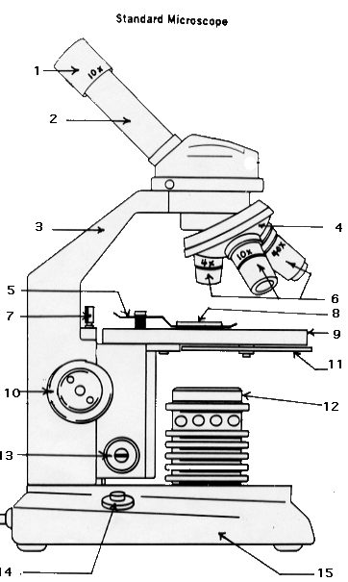
Microscope drawing

Slide 17
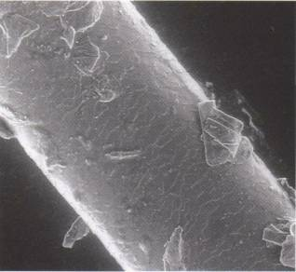
sem – human hair

Slide 18
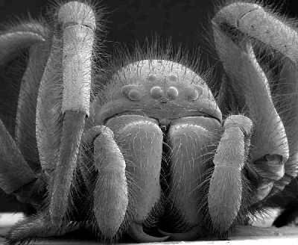
sem - spider

Slide 19
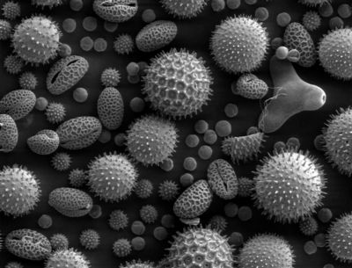
sem - pollen

Slide 20
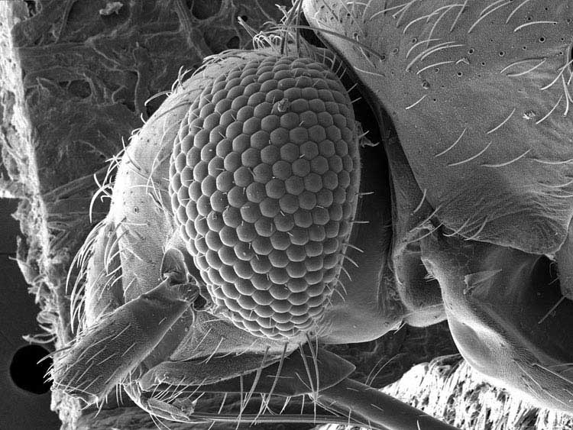
sem – fly’s head

Slide 21
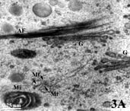
tem – pollen grains

Slide 22
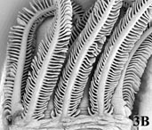
tem – fish gills

Slide 23
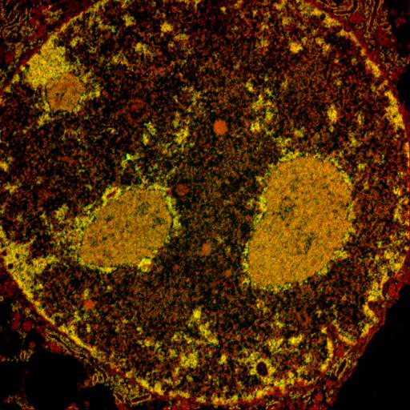
tem – cell’s nucleus

Slide 24
HOW TO USE THE SCOPes!
http://www.youtube.com/watch?NR=1&v=2xdMaeLJ2Mg&feature=endscreen
http://www.youtube.com/watch?v=jP9HtcAvGDk
*** PAY ATTENTION!!

